Slide 1
Excel Tutorial 1: Getting Started with Excel

Slide 2
Objectives
Understand the use of spreadsheets and Excel
Learn the parts of the Excel window
Scroll through a worksheet and navigate between worksheets
Create and save a workbook file
Enter text, numbers, and dates into a worksheet
Resize, insert, and remove columns and rows
2

Slide 3
Objectives
Select and move cell ranges
Insert formulas and functions
Insert, delete, move, and rename worksheets
Work with editing tools
Preview and print a workbook
3

Slide 4
Visual Overview

Slide 5
The Excel Window

Slide 6
Introducing Microsoft Excel 2010
Computer program used to enter, store, analyze, and present quantitative data
Creates electronic versions of spreadsheets
Collection of text and numbers laid out in a grid
Displays values calculated from data
Allows what-if analysis
Ability to change values in a spreadsheet and assess the effect they have on calculated values

Slide 7
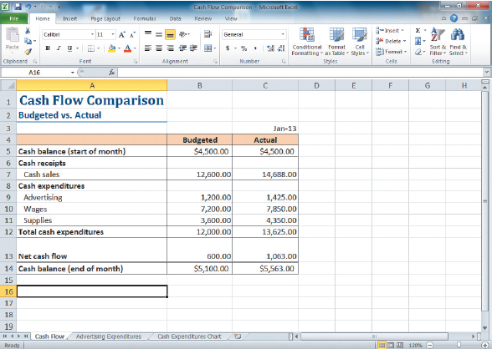
Spreadsheet Data in Excel

Slide 8
Worksheet Navigation
A workbook can have two kinds of sheets:
Worksheet contains a grid of rows and columns into which user enters data
Chart sheet provides visual representation of data
Cell reference identifies column/row location

Slide 9
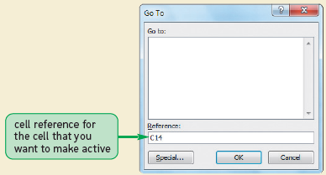
Worksheet Navigation
To navigate between worksheets
Use sheet tabs
To navigate within a worksheet
Use mouse, keyboard, GoTo dialog box, or type cell reference in Name box

Slide 10
Worksheet Navigation Keys

Slide 11
Planning a Workbook
Use a planning analysis sheet to define:
Goal or purpose of workbook
Type of data to collect
Formulas needed to apply to data you collected and entered
Appearance of workbook content

Slide 12
Entering Text, Numbers, and Dates
Text data
Combination of letters, numbers, and symbols
Often referred to as a text string
Number data
Numerical value to be used in a mathematical calculation
Date and time data
Commonly recognized formats for date and time values

Slide 13
Entering Text
New data appears in both the active cell and the formula bar
Truncation
AutoComplete feature
To enter multiple lines of text within a cell
Create a line break with Alt + Enter

Slide 14
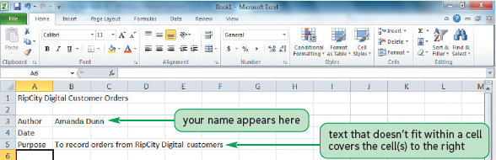
Entering Text

Slide 15
Entering Numbers

Slide 16
Working with Columns and Rows
To make data easier to read:
Modify size of columns and rows in a worksheet
To modify size of columns or rows:
Drag border to resize
Double-click border to autofit
Format the Cells group to specify

Slide 17
Working with Columns and Rows
Column width
Expressed in terms of number of characters or pixels (8.43 characters equals 64 pixels)
Note: Pixel size is based on screen resolution
Row height
Measured in points (1/72 of an inch) or pixels
Default row height: 15 points or 20 pixels

Slide 18
Working with Columns and Rows

Slide 19
Working with Columns and Rows
Inserting a column or row
Existing columns or rows shift to accommodate

Slide 20
Working with Columns and Rows
Deleting and clearing a row or column
Deleting removes both the data and the cells
Clearing removes the data, leaving blank cells where data had been

Slide 21
Visual Overview

Slide 22
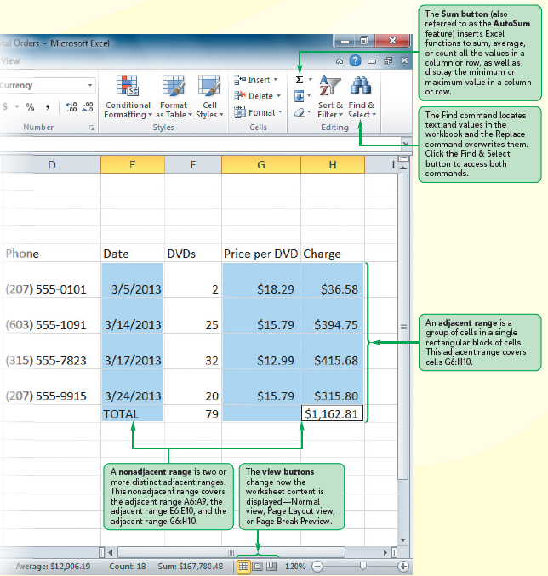
Worksheet Data

Slide 23
Working with Cells and Ranges
Range reference indicates location and size of a cell range
Adjacent (A1:G5)
Nonadjacent (A1:A5;F1:G5)
Selecting a range
Work with all cells in the range as a group
Moving and copying a range
Drag and drop
Cut and paste

Slide 24
Working with Cells and Ranges
Inserting and deleting a range
Existing cells shift to accommodate the change

Slide 25
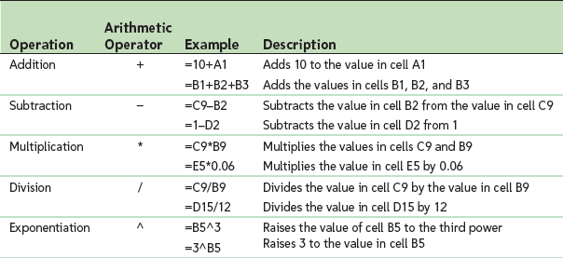
Working with Formulas
Formula
An expression that returns a value
Written using operators that combine different values, resulting in a single displayed value

Slide 26
Working with Formulas
Entering a formula
Click cell where you want formula results to appear
Type = and an expression that calculates a value using cell references and arithmetic operators
Cell references allow you to change values used in the calculation without having to modify the formula itself
Press Enter or Tab to complete the formula

Slide 27
Working with Formulas
Order of precedence
Set of predefined rules used to determine sequence in which operators are applied in a calculation

Slide 28
Working with Formulas
Viewing a formula
Select cell and review expression displayed in the formula bar
Each cell reference is color coded in the formula and corresponding cell in the worksheet

Slide 29
Working with Formulas
Copying and pasting formulas
Cell references adjust to reflect new location of the formula in the worksheet

Slide 30
Working with Formulas
Guidelines for writing effective formulas:
Keep them simple
Do not hide data values within formulas
Break up formulas to show intermediate results

Slide 31
Introducing Functions
Function
Named operation that returns a value
Simplifies a formula, reducing a long formula into a compact statement; for example, to add values in the range A1:A10:
Enter the long formula: =A1+A2+A3+A4+A5+A6+A7+A8+A9+A10 - or -
Use the SUM function to accomplish the same thing: =SUM(A1:A10)

Slide 32
Entering a Function

Slide 33
Entering Functions with AutoSum
Fast, convenient way to enter commonly used functions
Includes buttons to quickly insert/generate:
Sum of values in column or row (SUM)
Average value in column or row (AVERAGE)
Total count of numeric values in column or row (COUNT)
Minimum value in column or row (MIN)
Maximum value in column or row (MAX)

Slide 34
Entering Functions with AutoSum

Slide 35
Working with Worksheets
Inserting a worksheet
Name of new worksheet is based on number and names of other sheets in the workbook
Deleting a worksheet
Renaming a worksheet
31 characters maximum, including blank spaces
Width of sheet tab adjusts to length of name

Slide 36
Working with Worksheets
Moving and copying a worksheet
To move:
Click and drag
To copy:
Ctrl + drag and drop
Place most important worksheets at beginning of workbook (leftmost sheet tabs), less important worksheets toward end (rightmost tabs)

Slide 37
Editing Worksheet Content
Use Edit mode to edit cell contents
Keyboard shortcuts apply only to text within selected cell
Undoing and redoing an action
Excel maintains a list of actions performed in a workbook during current session

Slide 38
Editing Worksheet Content
Using find and replace

Slide 39
Editing Worksheet Content
Using the spelling checker

Slide 40
Previewing a Workbook
Changing worksheet views
Normal view
Page Layout view
Page Break Preview

Slide 41
Page Layout View

Slide 42
Page Break Preview

Slide 43
Previewing a Workbook
Working with page orientation
Portrait orientation (default)
Page is taller than wide
Landscape orientation
Page is wider than tall

Slide 44
Printing a Workbook
Print tab provides options for choosing what to print and how to print
Printout includes only the data in the worksheet
Other elements (e.g., row/column headings, gridlines) will not print by default
Good practice: Review print preview before printing to ensure that printout looks exactly as you intended and avoid unnecessary reprinting

Slide 45
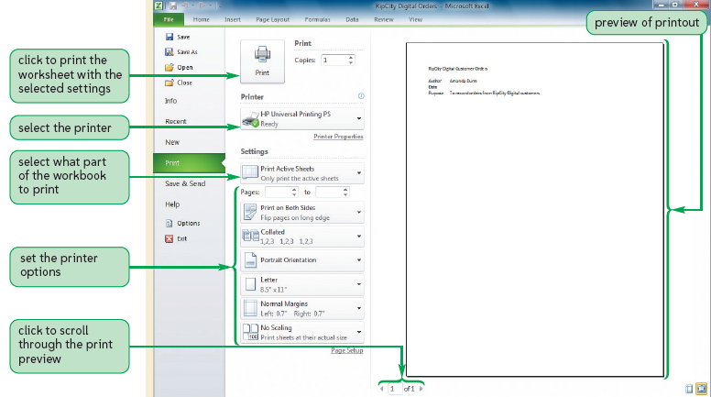
Printing a Workbook

Slide 46
Viewing and Printing Worksheet Formulas
Switch to formula view
Useful when you encounter unexpected results and want to examine underlying formulas or to discuss your formulas with a colleague

Slide 47
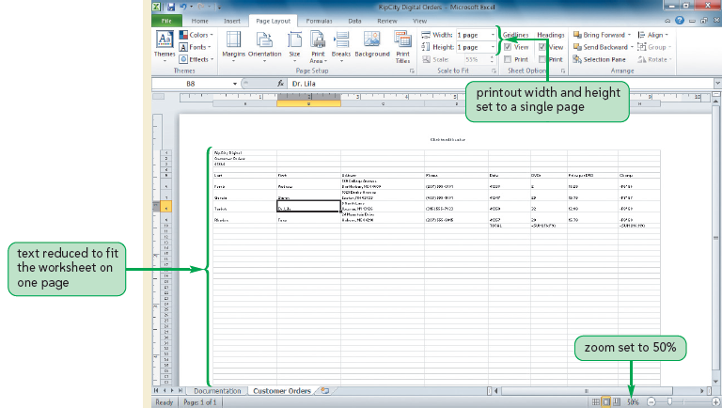
Viewing and Printing Worksheet Formulas
Scaling the printout of a worksheet forces contents to fit on a single page

